Slide 1
Finite Projective Planes
Merilee and John

Slide 2
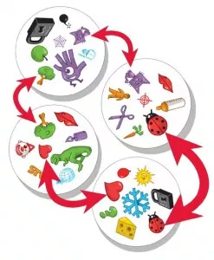
Let’s Play a Game! Spot It!
How to play:
Each player take one card
Place the rest of the cards face up in the middle
First person to match an object on the middle card to there card gets to take the middle card
Repeat until all cards are gone
Count the cards at the end, the person with the most cards wins!

Slide 3
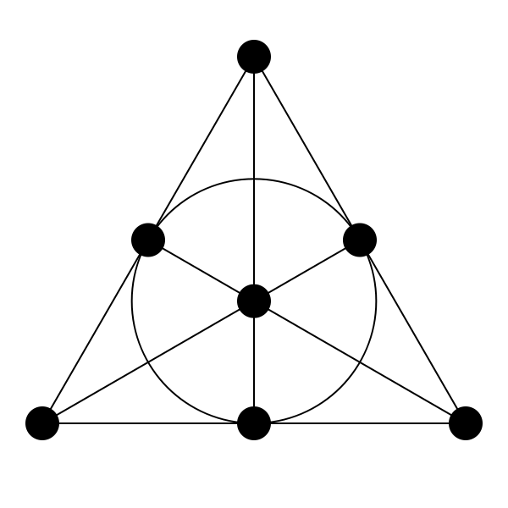
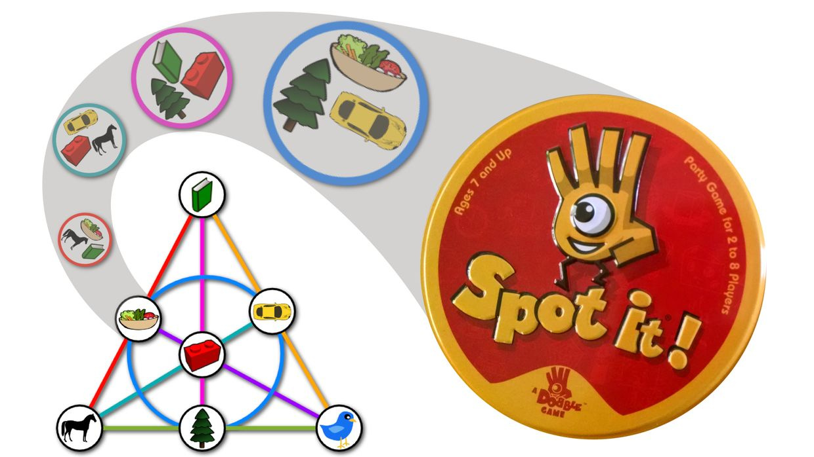
Why does this work?
There is only one match per set of card, how does this work?

Slide 4
Number of Cards?

Slide 5
Another Finite Plane - mod 3

Slide 6
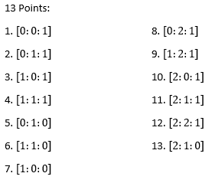

Slide 7
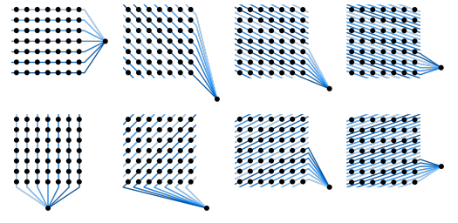
What modulo is Spot It in?

Slide 8
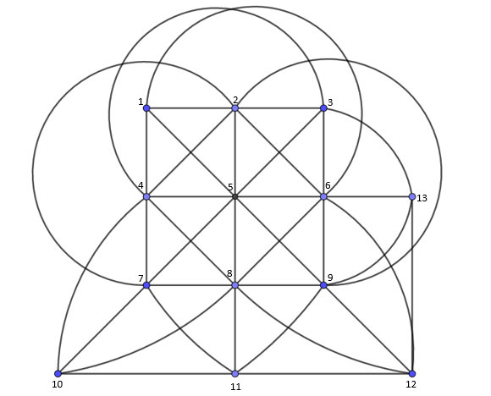
Make your own Spot It Game
Find all the different path
Choose a symbol for each number
Create 13 different card with 4 symbols on each
See if your game works!

Slide 9
Resources
https://www.patreon.com/posts/19693536
https://www.youtube.com/watch?v=lhTMr8RzUr8&t=259s

